Slide 1
python project presention
Created by:- KASHIFUDDIN

Slide 2
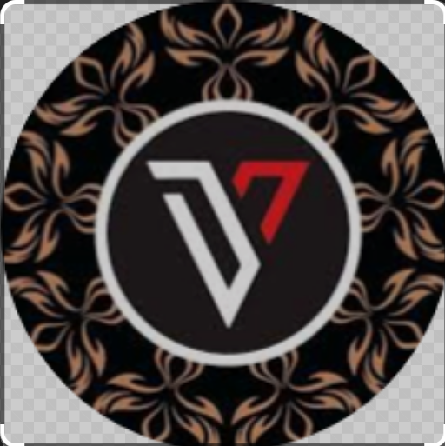
log in project
My project is on user login with id and password and how can
I check the password and username.

Slide 3
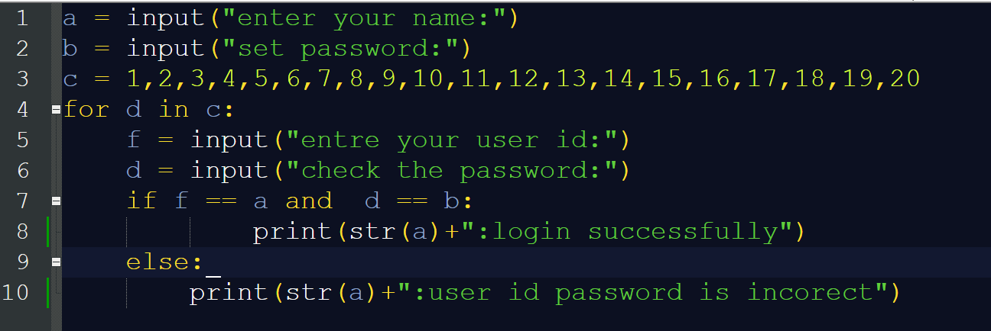
this is my code
this is my code and i used 4 input in it and a (for loop) and (if-else) function to checked the password and user id and we can checked user id password 20 times from input
i used (for loop) to show 1 particular condition for 20 times .

Slide 4
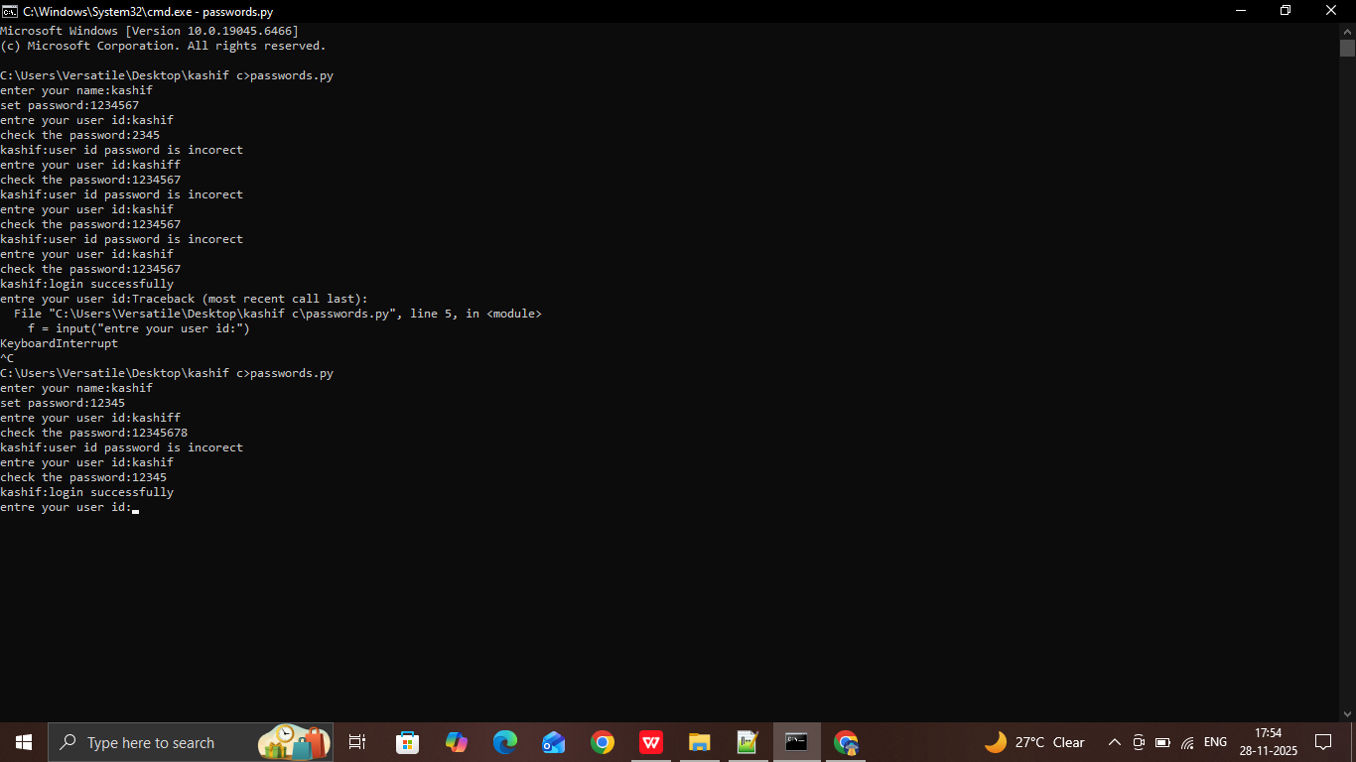
This is what my output was came
Created by:- KASHIFUDDIN

Slide 5
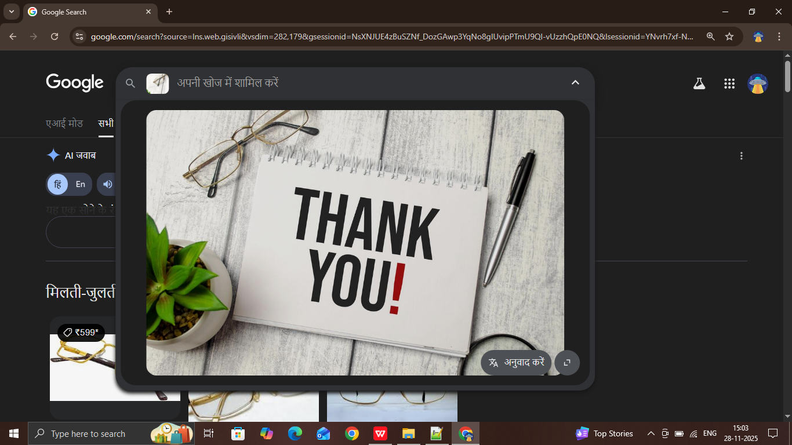
Thank You Everyone

